Slide 1
Weekly Progress
Classification
k-fold stratified cross validations
Correlation columns grouping
Corr, ABS(Corr), Corr^2
Higher difference correlation within group
Trying with classification benchmark problem?
Grouping with columns sequence?

Slide 2
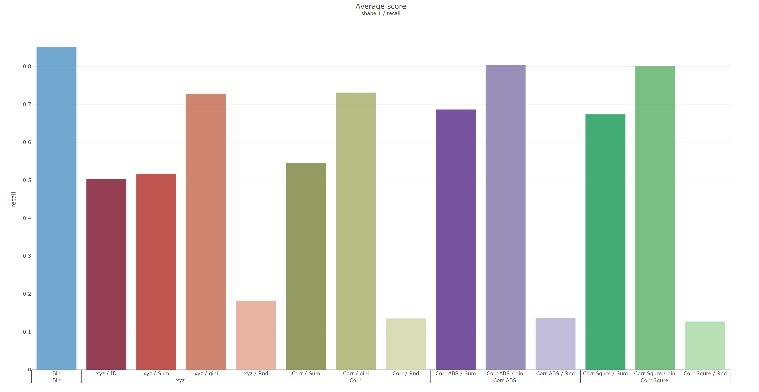
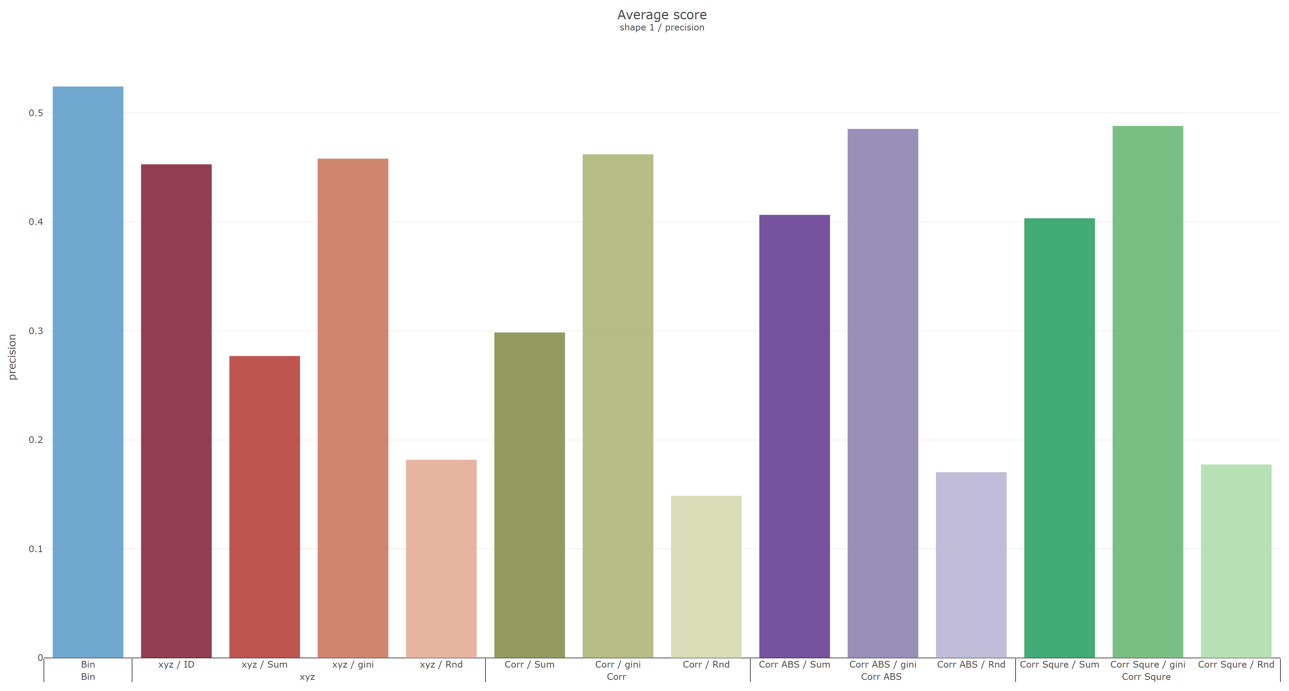
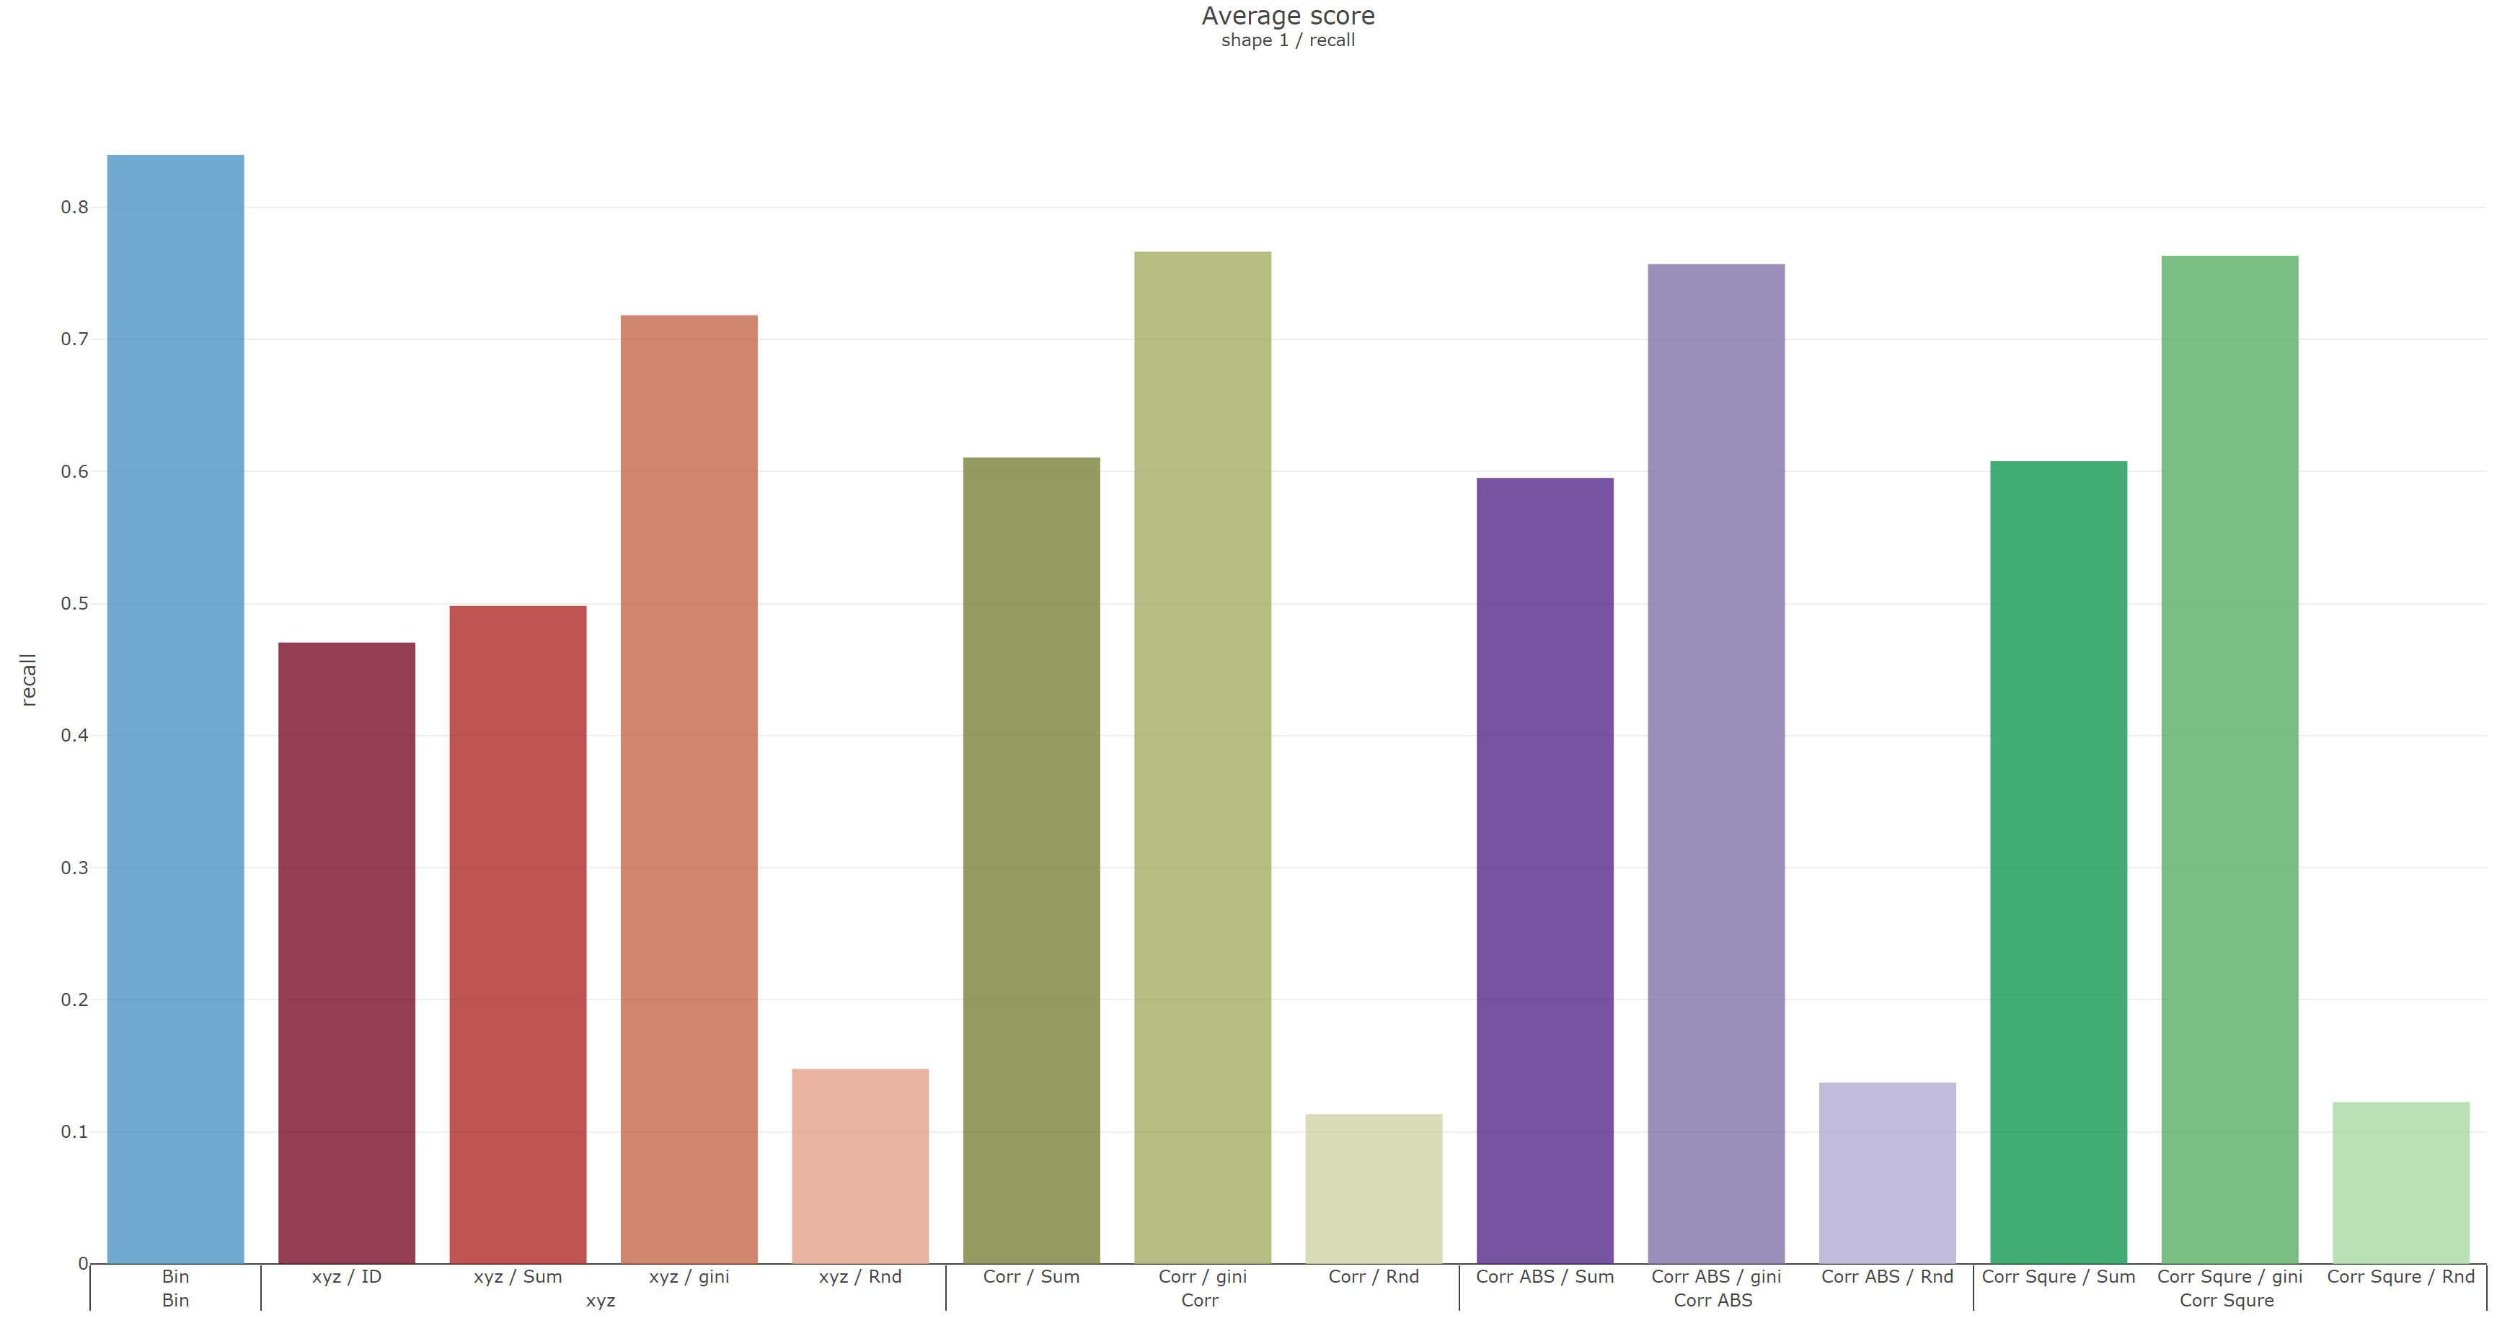
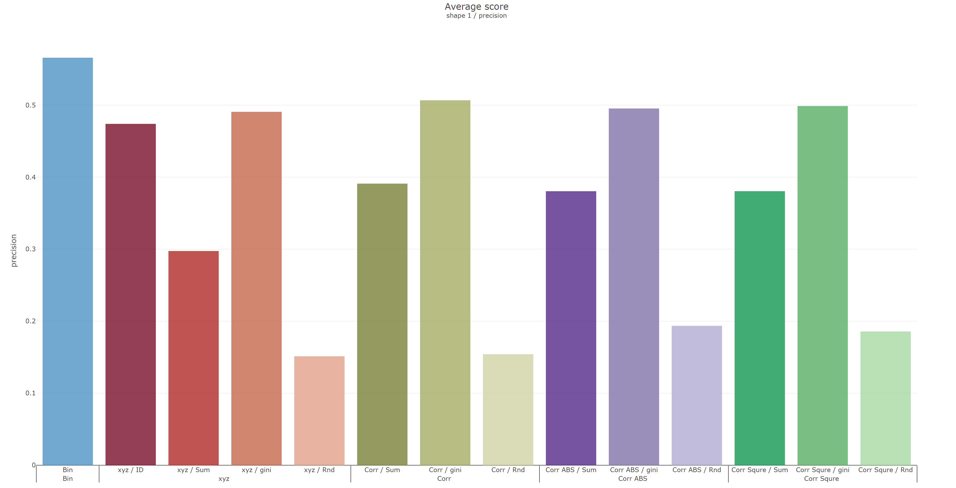
Shape 1
 | Recall | Precision
Reverse
Original

Slide 3
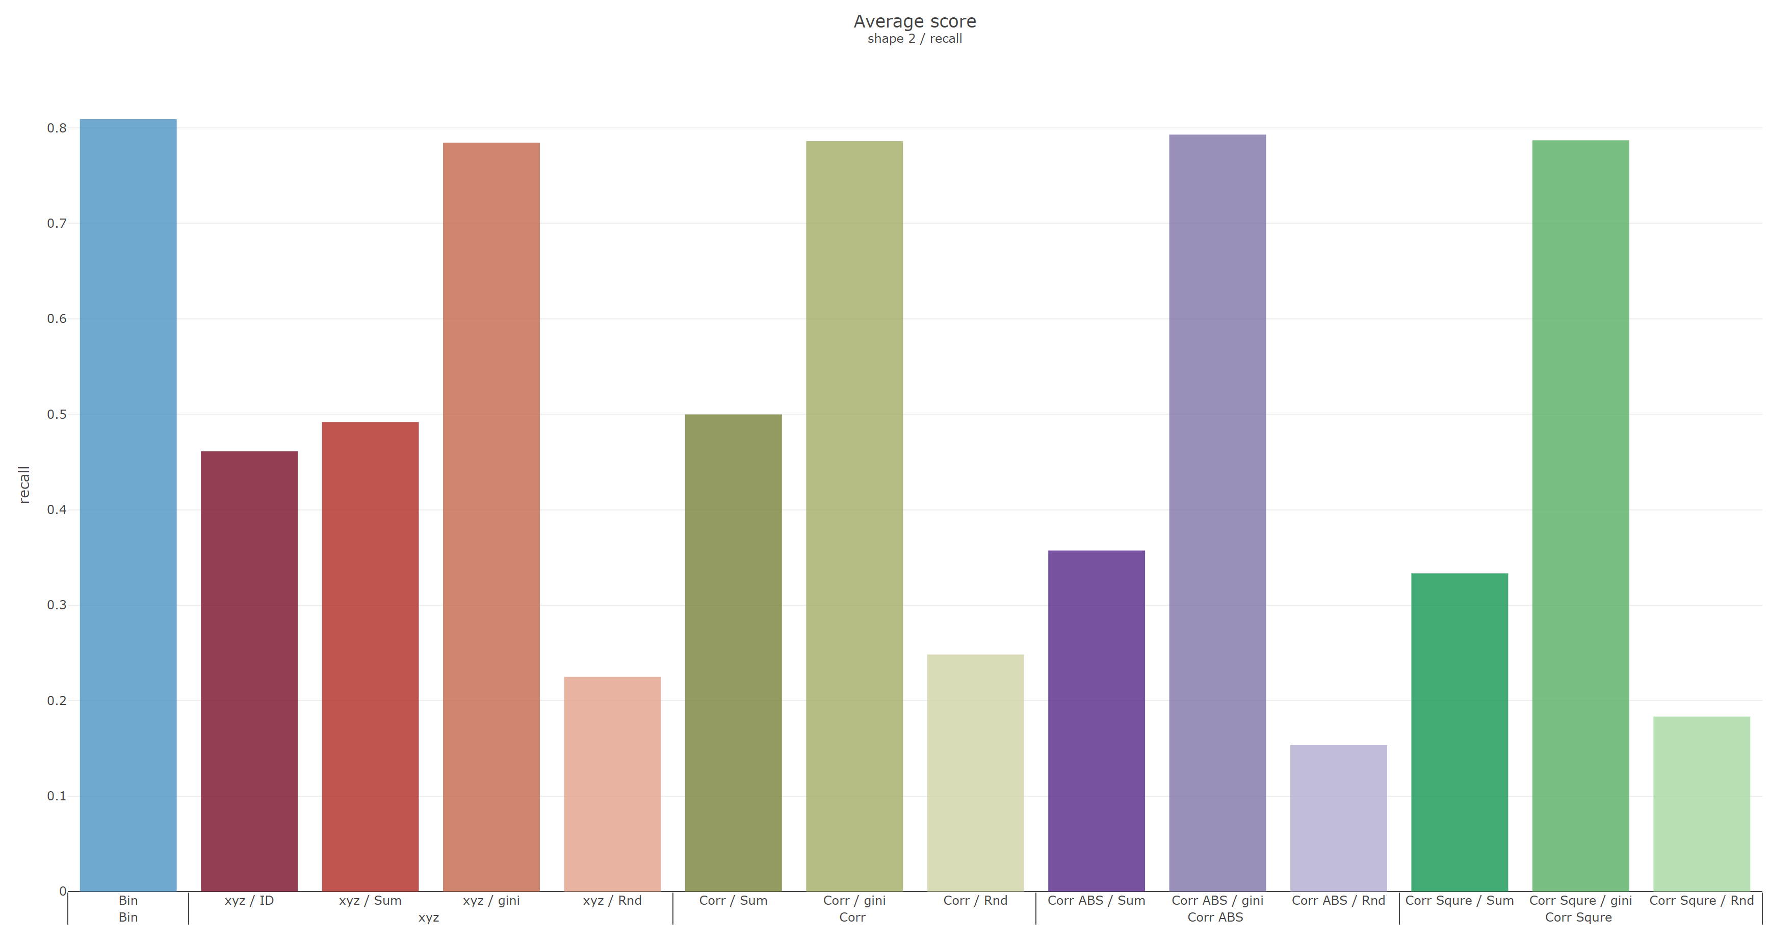
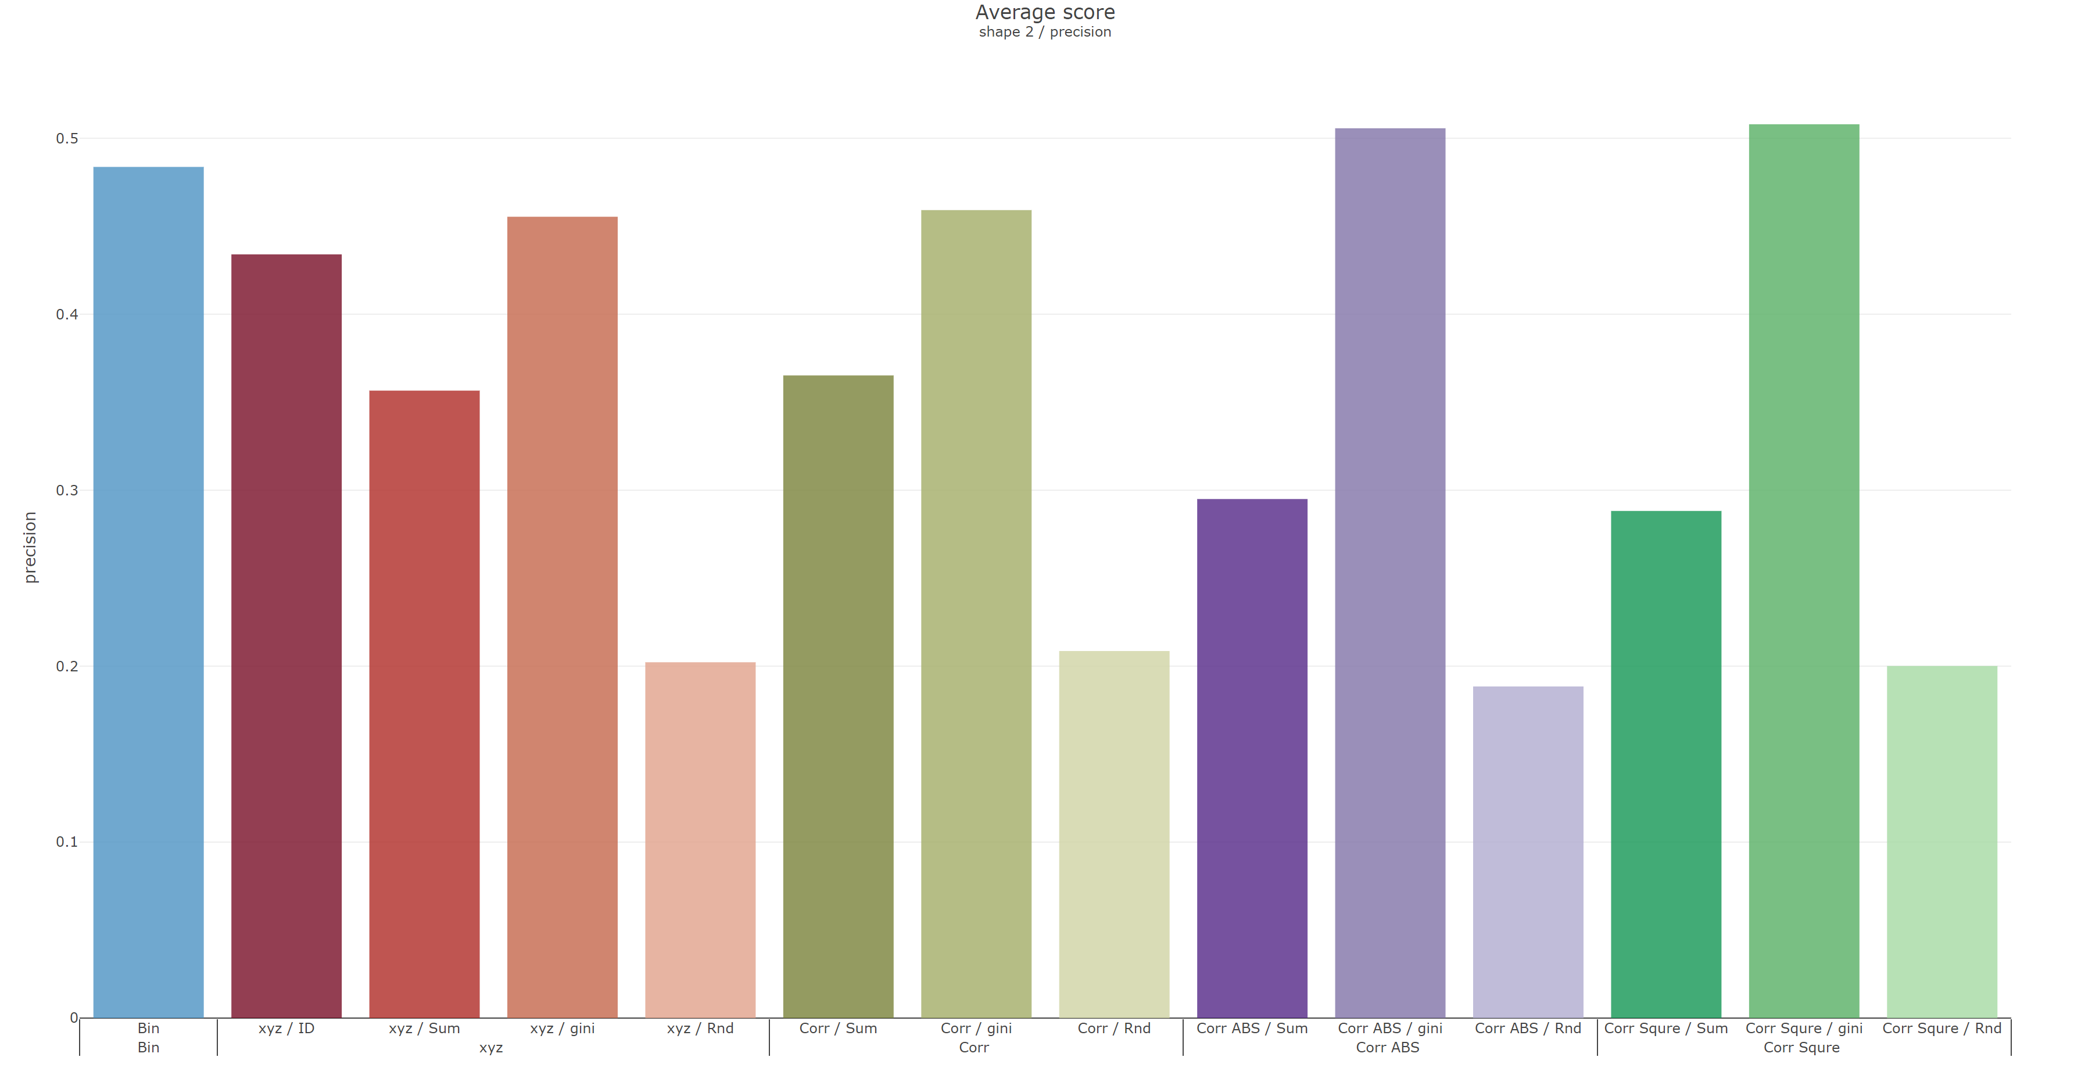
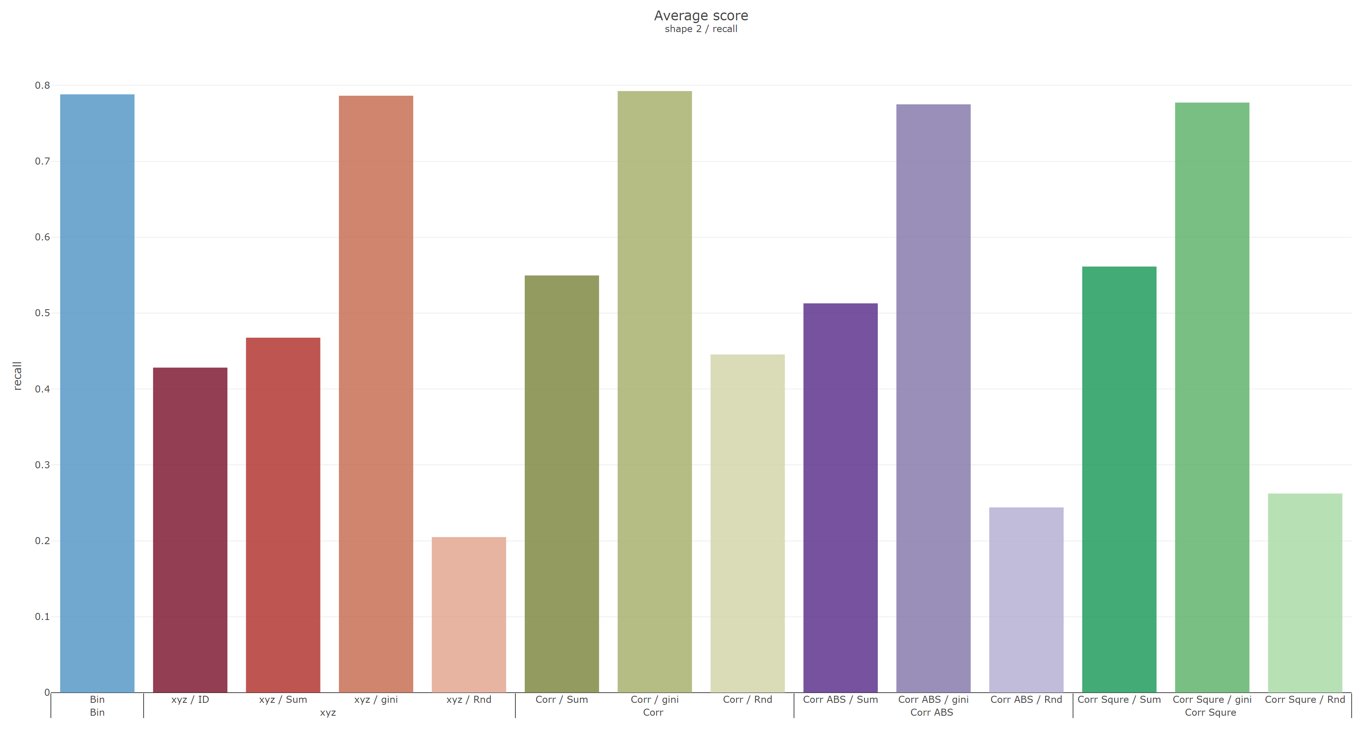
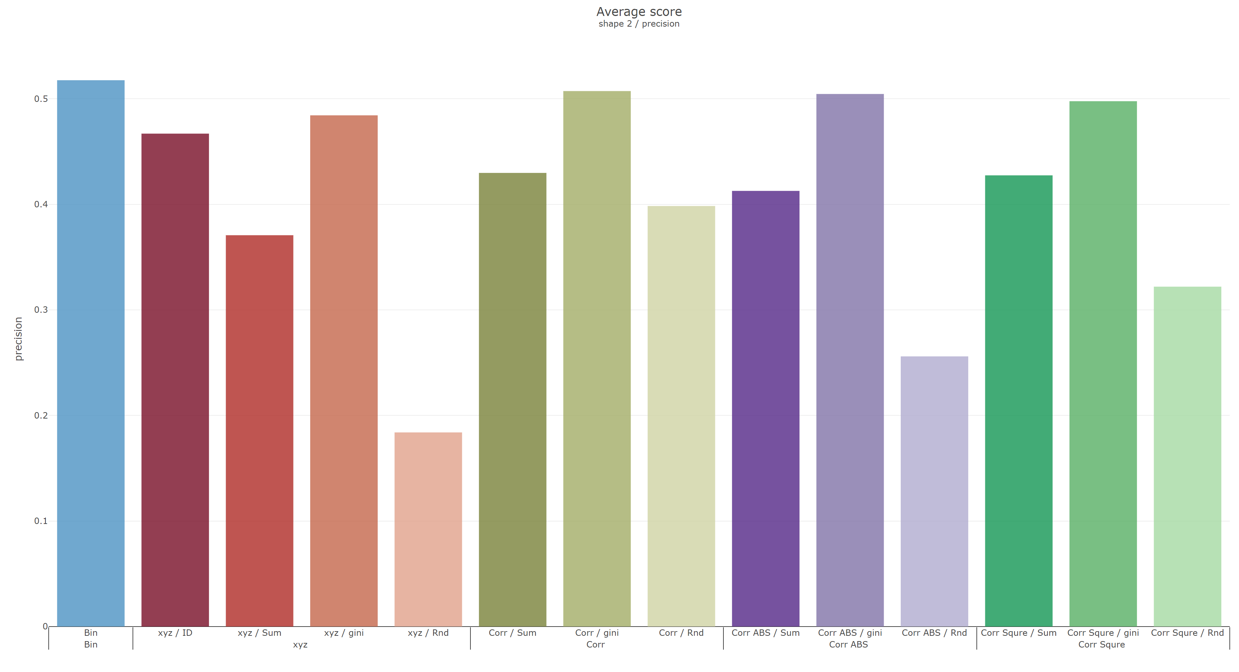
Shape 2
 | Recall | Precision
Reverse
Original

Slide 4
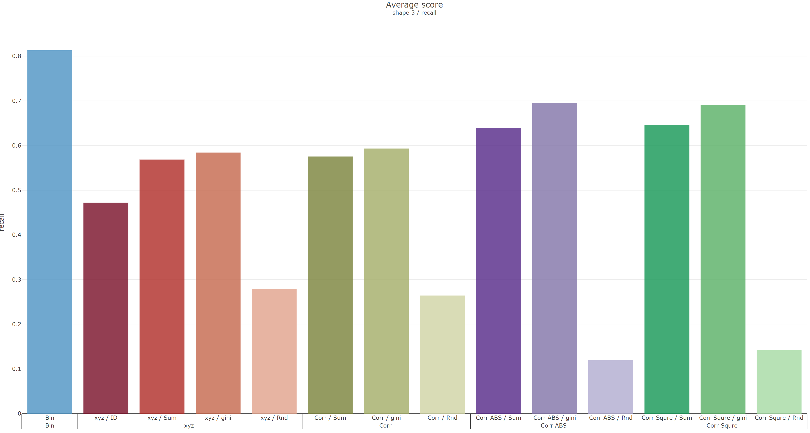
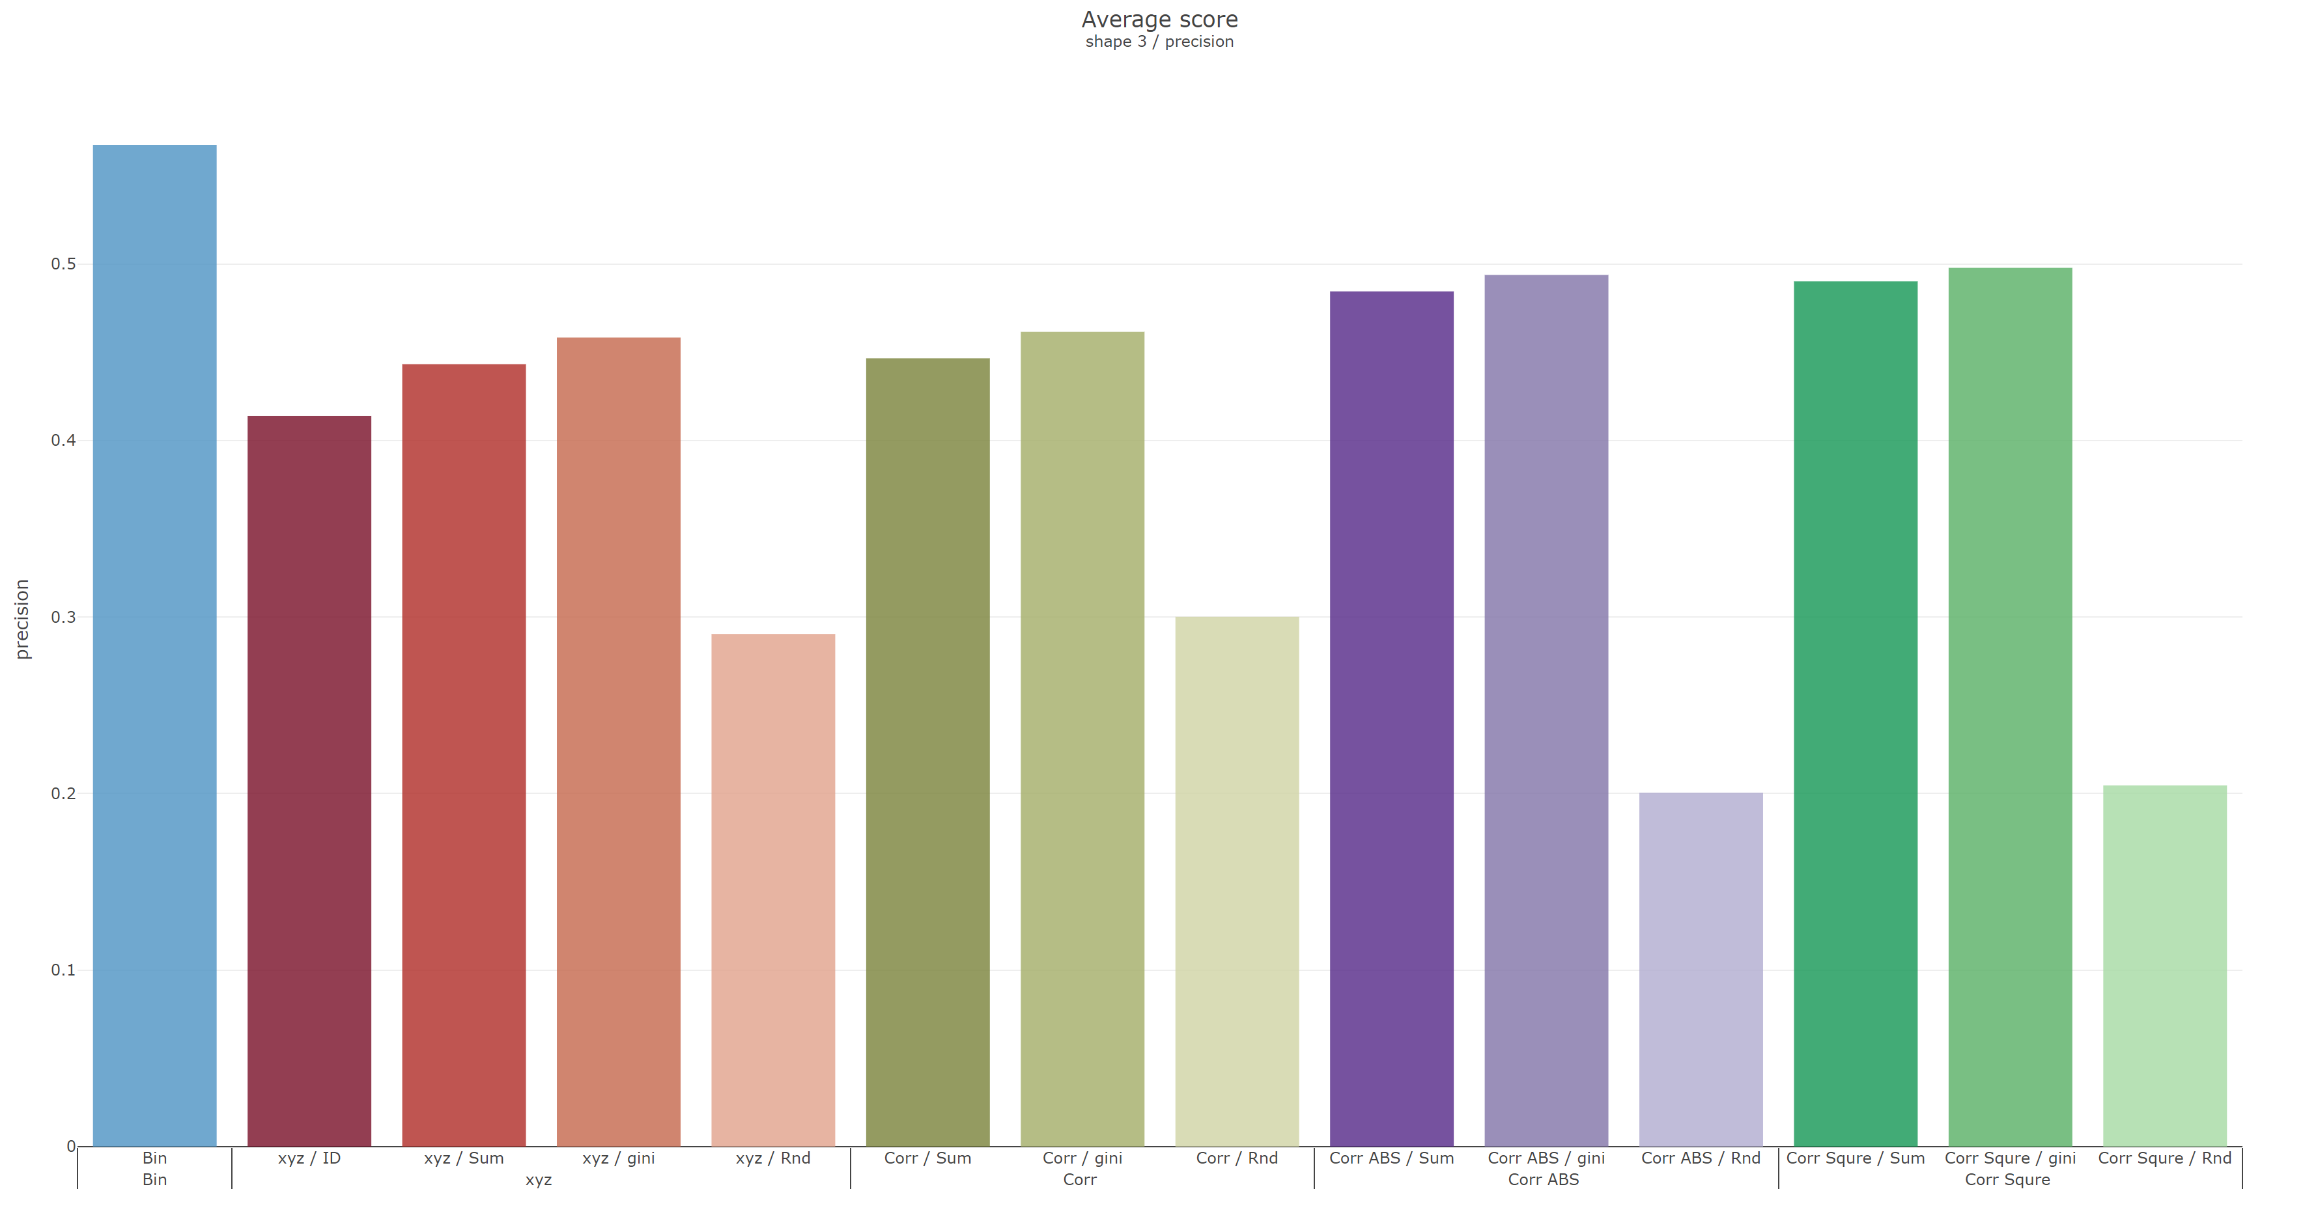
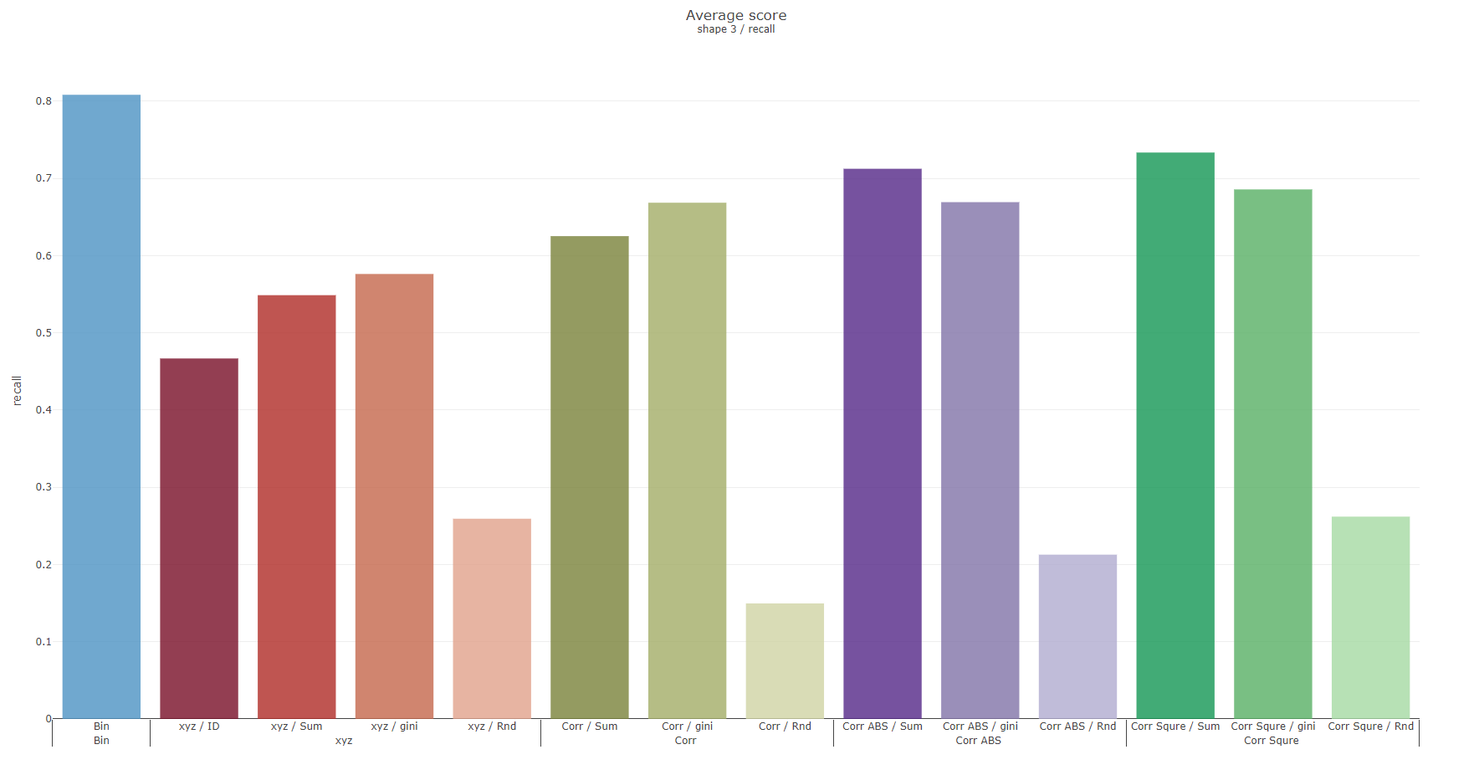
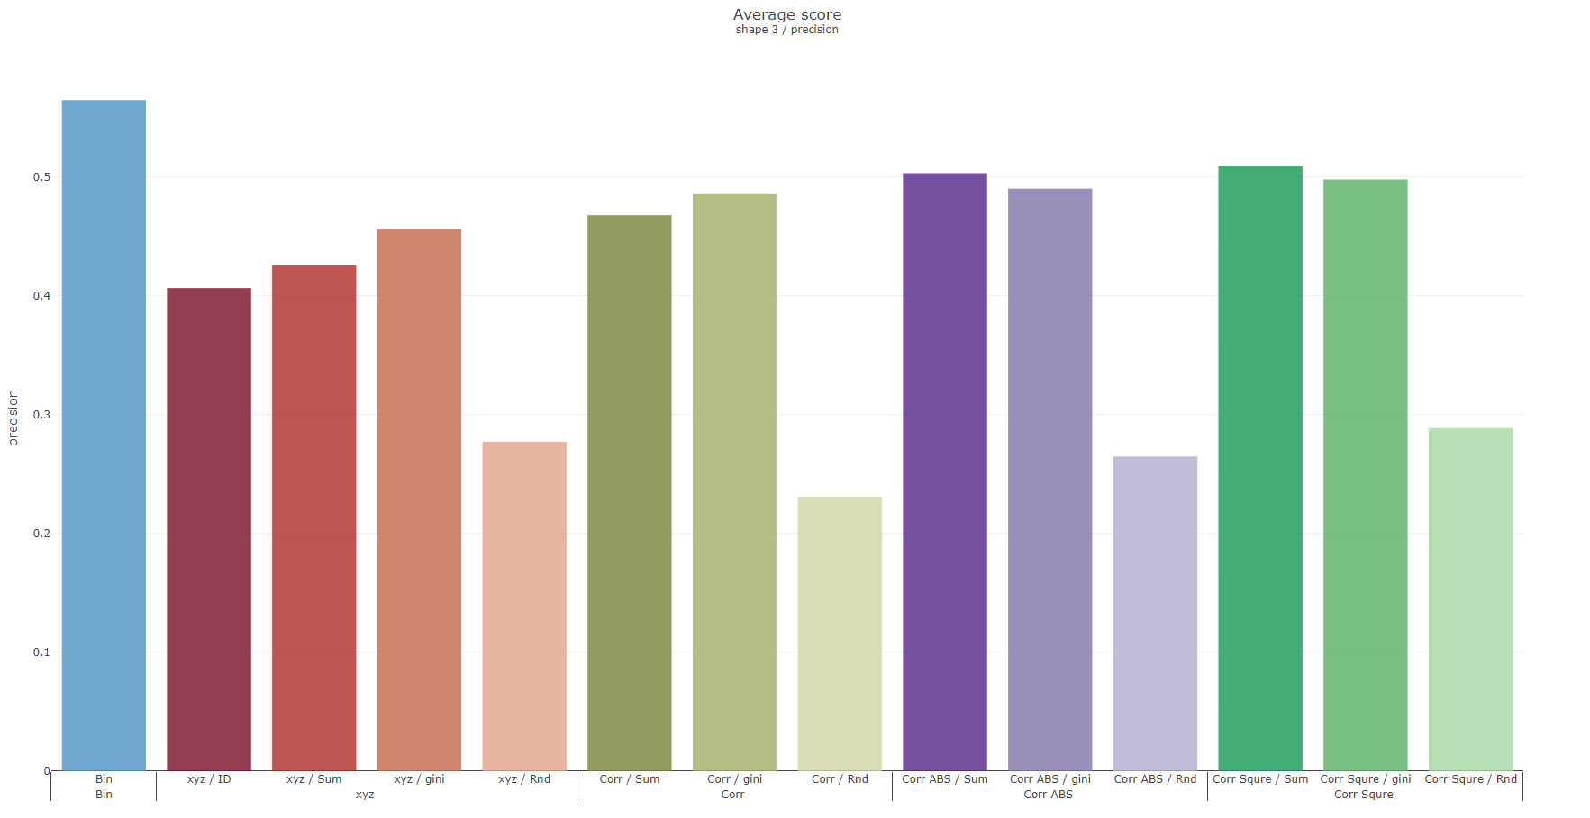
Shape 3
 | Recall | Precision
Reverse
Original

Slide 5
Grouping with columns sequence
S sorting
G-1 | G-2 | G-3 | G-4 | G-5 | G-6 | G-7
G-14 | G-13 | G-12 | G-11 | G-10 | G-9 | G-8
G-15 | G-16 | G-17 | G-18 | G-19 | G-20 | G-21
Notes:
K-fold deviation
Hybird dataset(cont., binary)
UCI
確認遠端還是實體口試

Slide 6
Record K-fold deviation
Grouping with columns sequence
Testing hybrid dataset(both cont. and bin.) on UCI
Make sure remote or physical oral test

Slide 7
Weekly Progress
Classification
Record K-fold deviation
Compared with ordinal, and mean encoding
Testing with UCI datasets on 4, and 10-folds
Car Evaluation Data Set
Adult Data Set
Grouping with columns sequence
Try with others UCI datasets

Slide 8
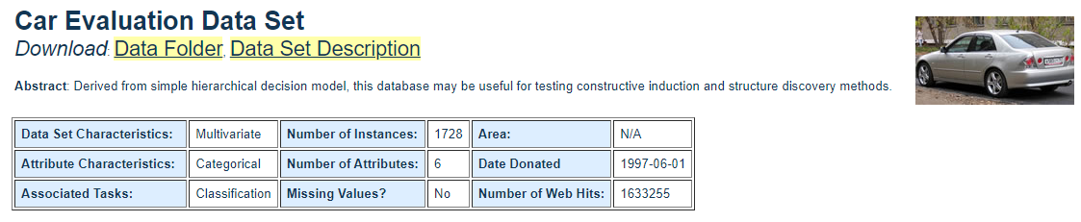
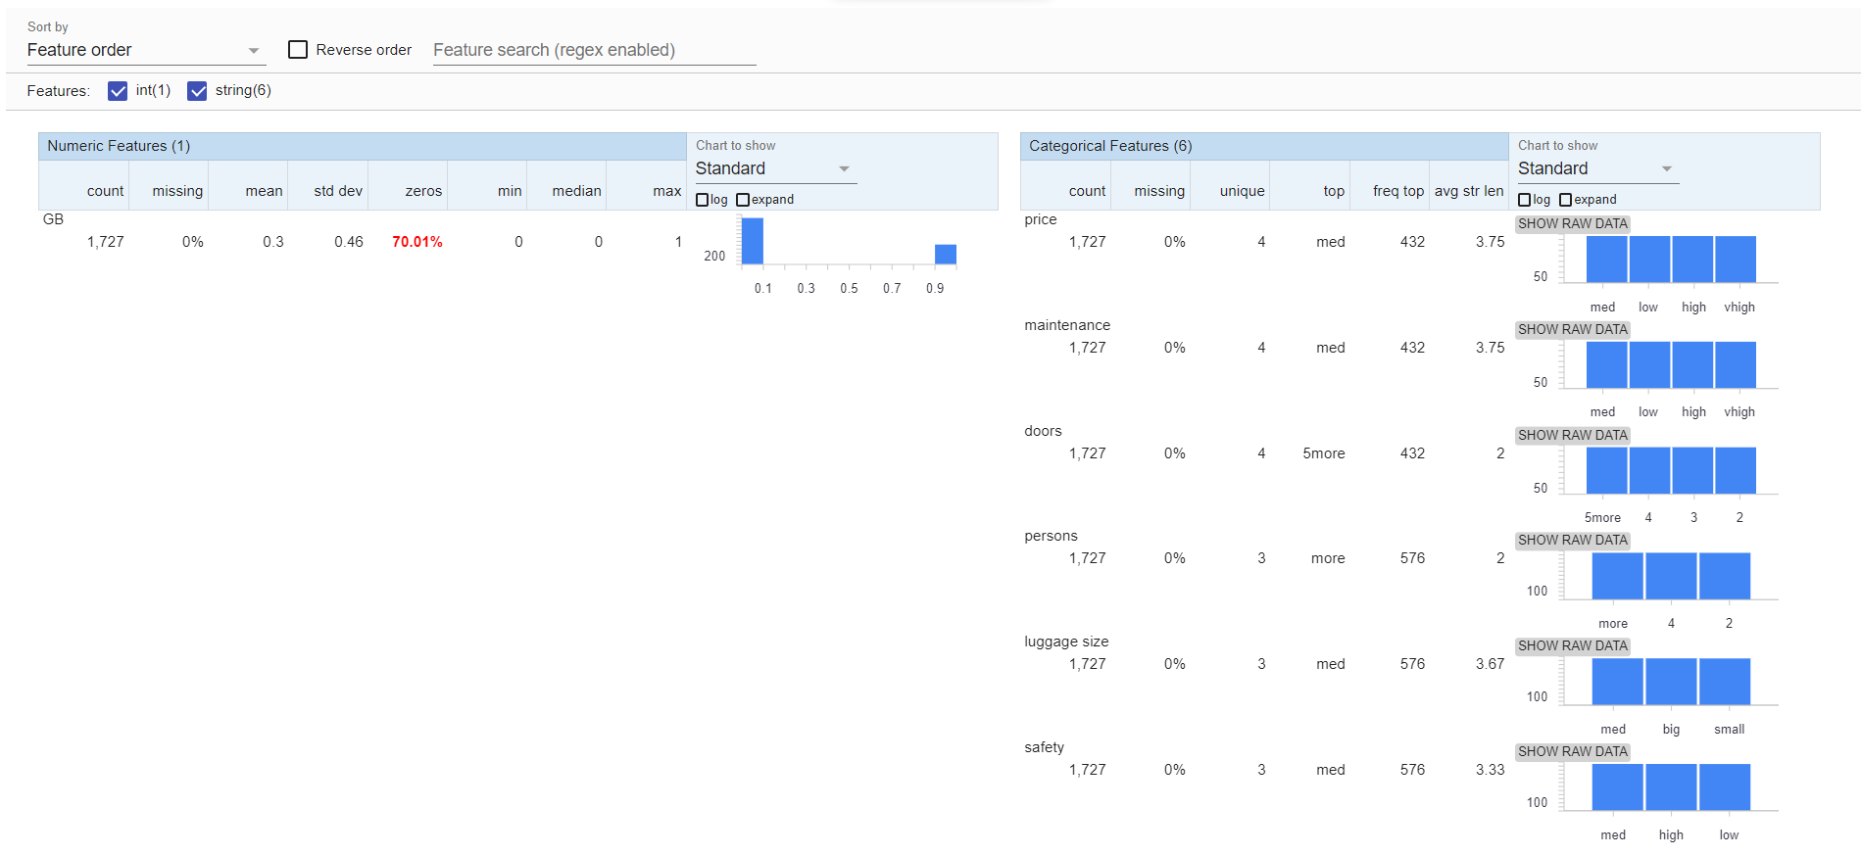
Car Evaluation Data Set

Slide 9
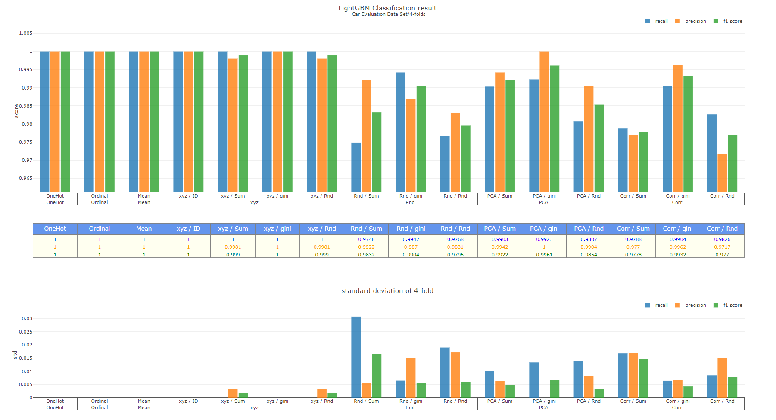

Slide 10
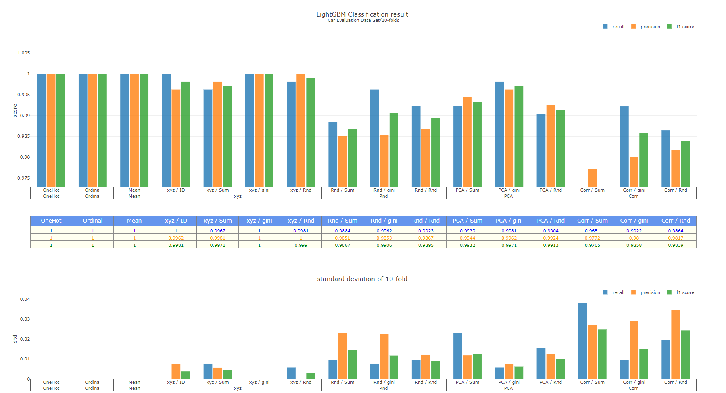

Slide 11
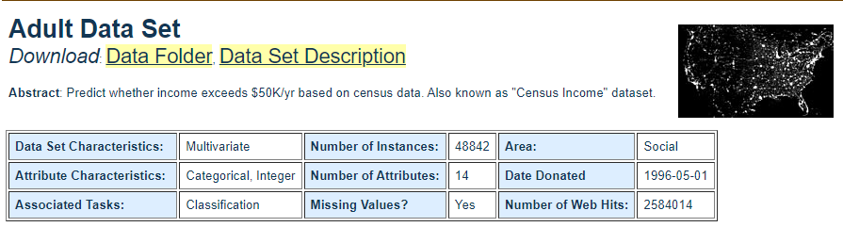
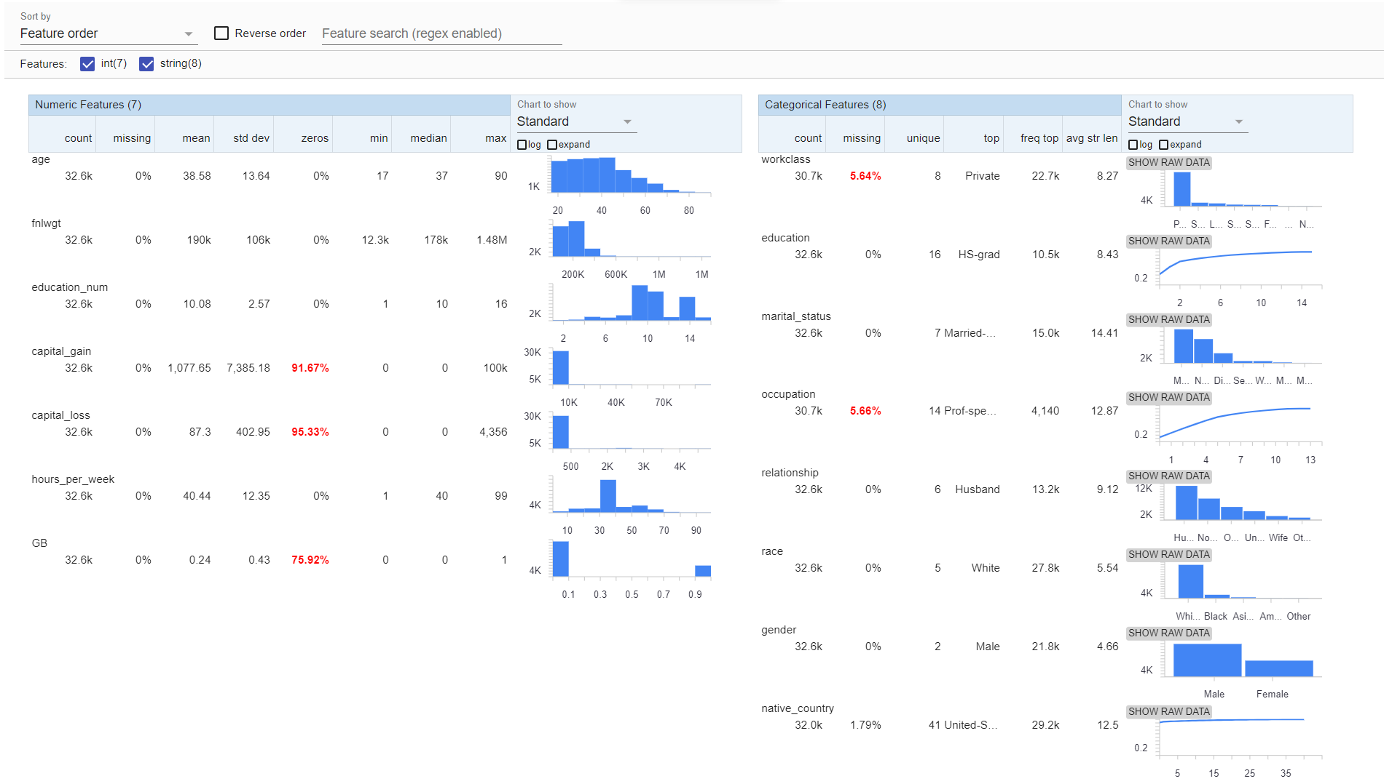
Adult Data Set

Slide 12
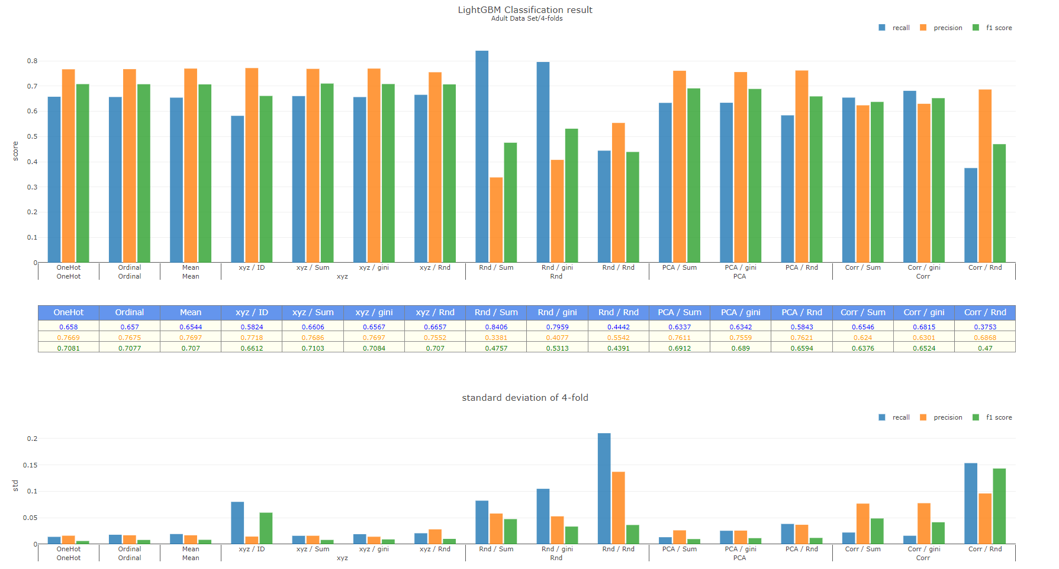

Slide 13
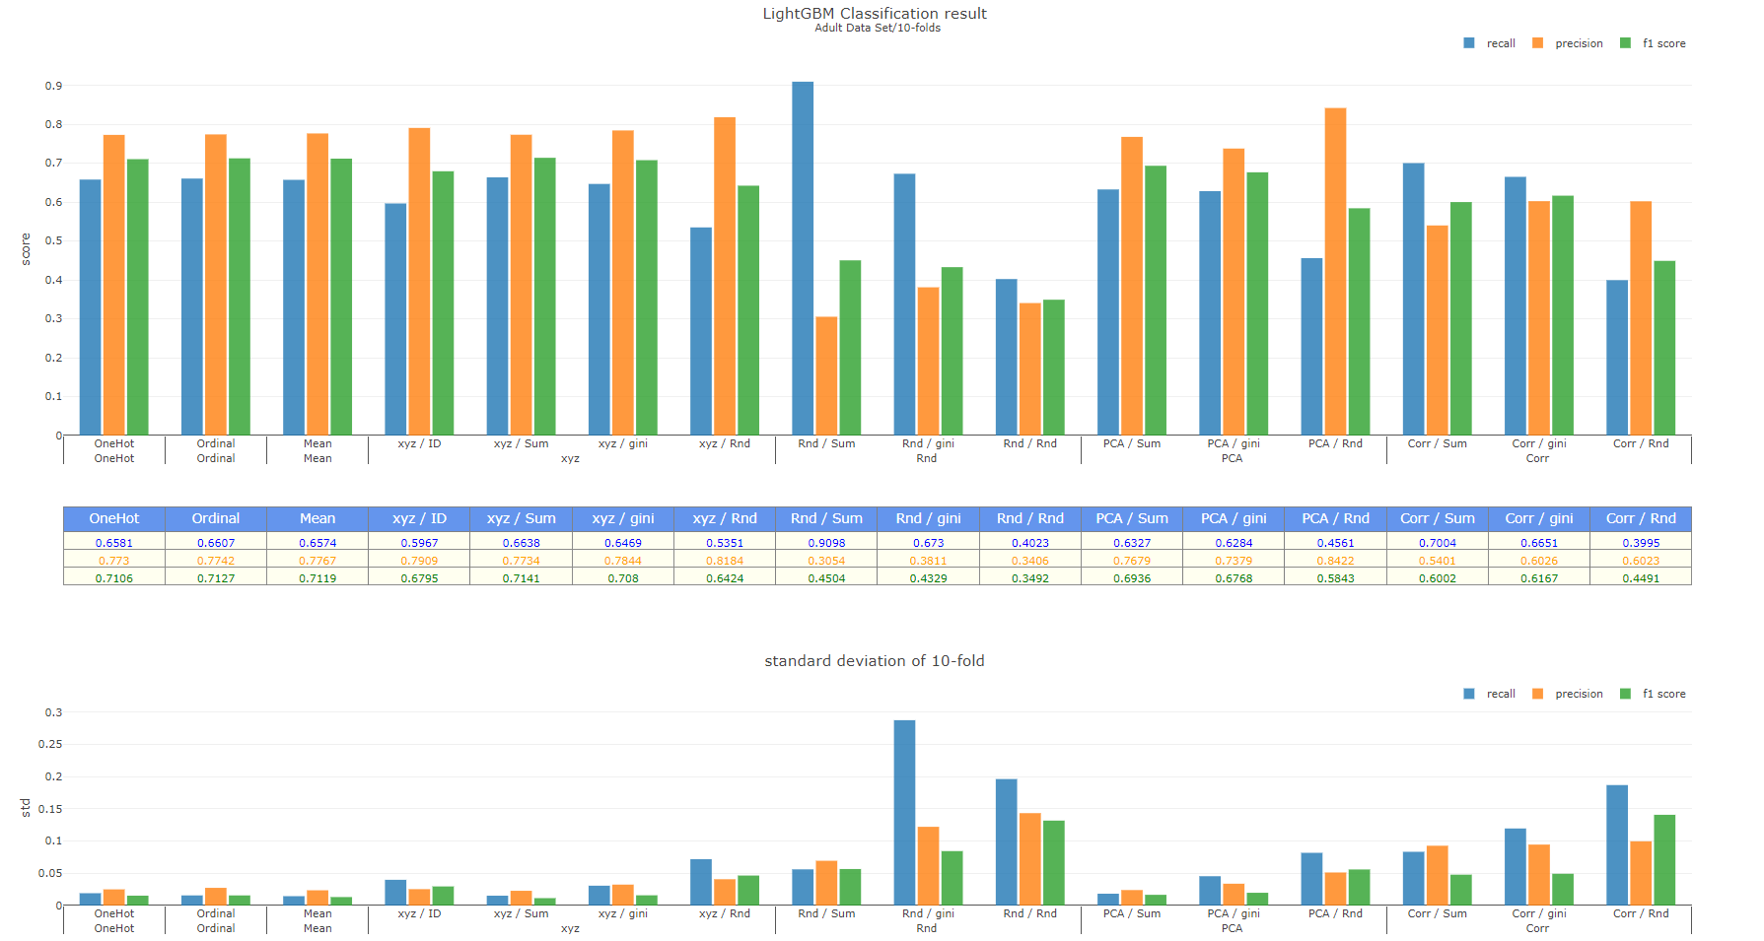
Notes:
Feature importance
AUO data
Imbalance
Kaggle, PWC
信用卡盜刷
目錄

Slide 14
To-do
Datasets
AUO data
Imbalance (Kaggle, UCI, paper with code)
信用卡盜刷
Classification
Record feature importance
Thesis
Chapter 3,4 目錄

Slide 15
緒論
文獻回顧
研究方法
案例分析
結論與建議

Slide 16
0 | 0.2 |  |  |  |  |  |  | 1
0 |  |  | 0.45 |  |  |  |  | 1
0 |  |  | 0.45 |  |  |  |  | 1

Slide 17
Weekly Progress
Testing with AUO datasets on 2, and 3-folds
Original
Backward one hot encoded
Grouping with columns sequence
Testing with other imbalance datasets

Slide 18
New operation binding approach
AS is
To be
Instead of using operation code title, we switch to the( ± machine code) in column binding. And This approach change the number of operation column from 9 to 17.
Notes:
New operation binding approach

Slide 19
Dataset sizes in different month No.
Dataset sizes
 | m8 | m9 | m10 | m11 | m12 | m1 | m2 | m3 | m4 | m5 | m6 | m7
Col (Original) | 151 | 150 | 150 | 150 | 153 | 146 | 150 | 157 | 154 | 157 | 155 | 152
Col (Machine) | 106 | 105 | 103 | 97 | 103 | 95 | 105 | 109 | 101 | 105 | 105 | 103
Col (Chamber) | 414 | 397 | 271 | 194 | 288 | 170 | 208 | 235 | 198 | 207 | 173 | 175
Row count | 23214 | 21526 | 18148 | 19037 | 20629 | 17735 | 39009 | 60396 | 57743 | 48649 | 7792 | 43245
GB = 1 count | 8 | 12 | 13 | 8 | 17 | 7 | 31 | 46 | 54 | 51 | 7 | 37

Slide 20
Notes:
Chamber columns 400-100(?

Slide 21
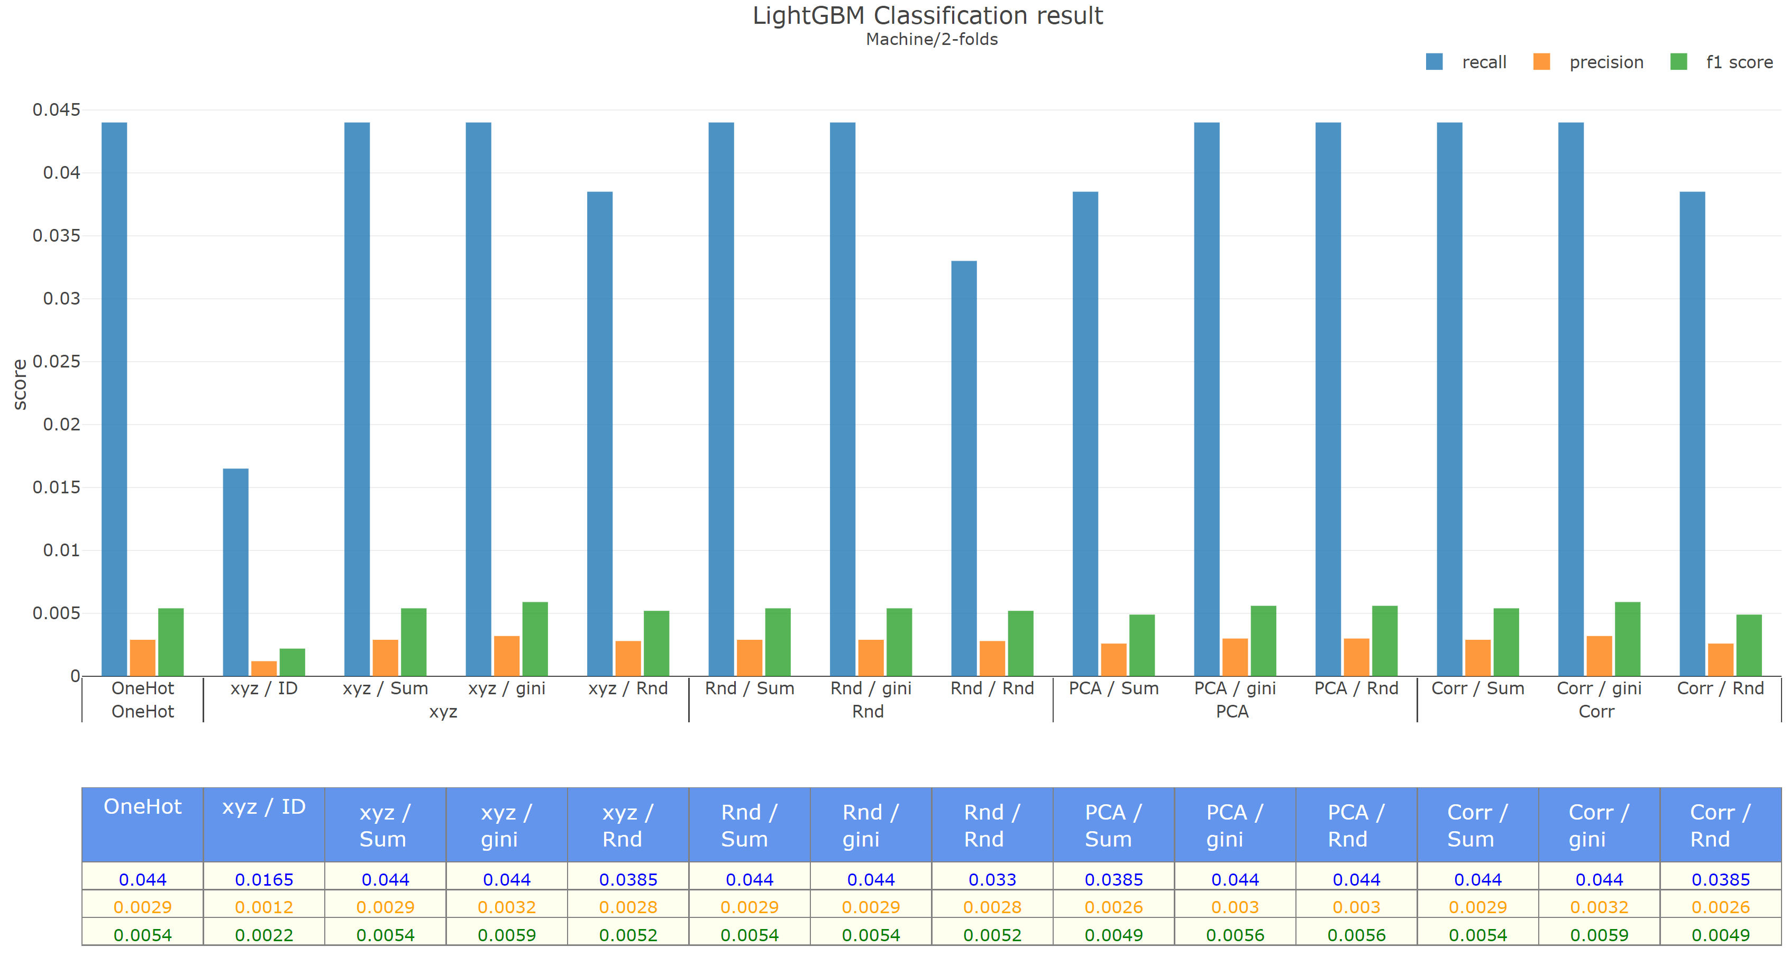
Original | Machine | 2-folds

Slide 22
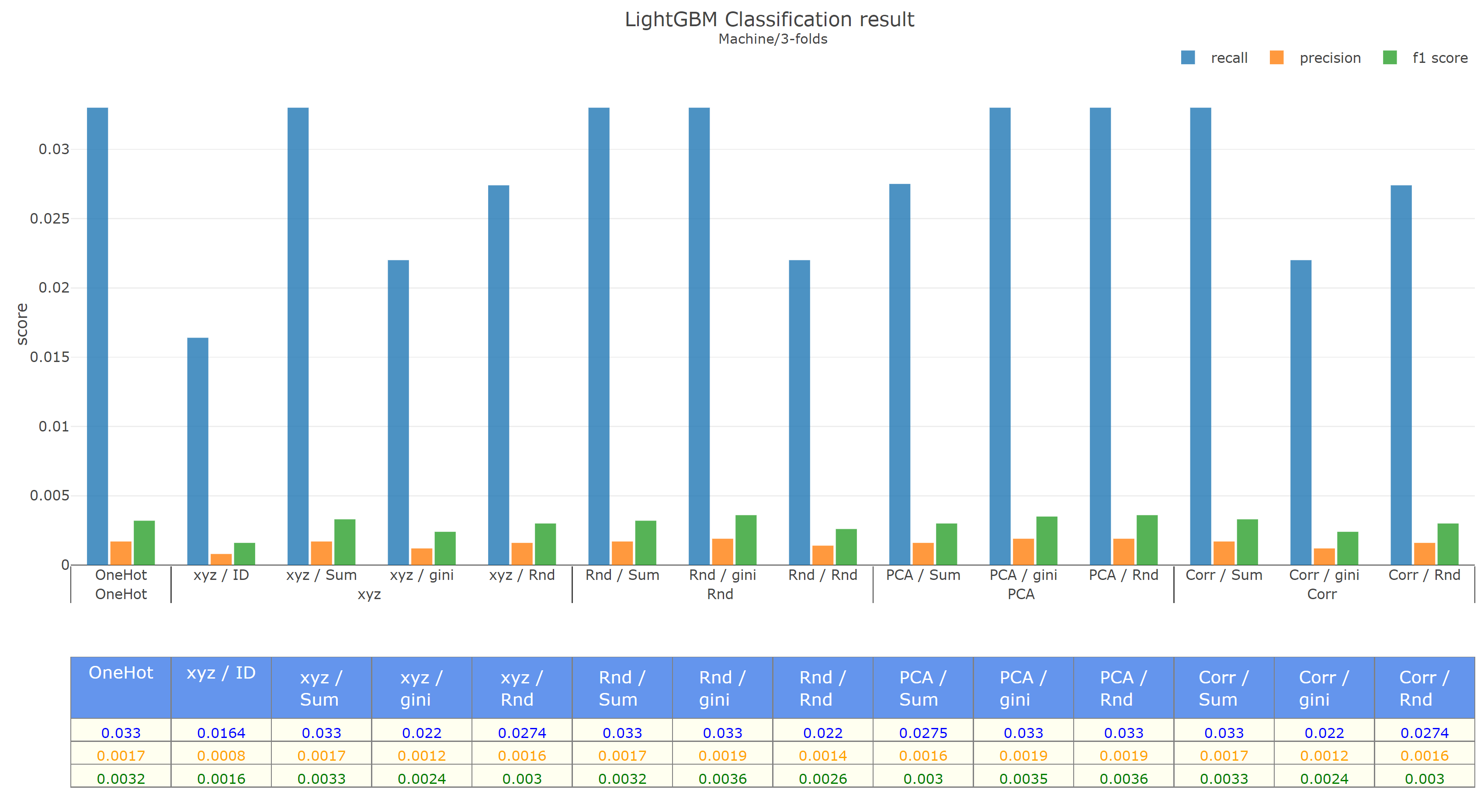
Original | Machine | 3-folds

Slide 23
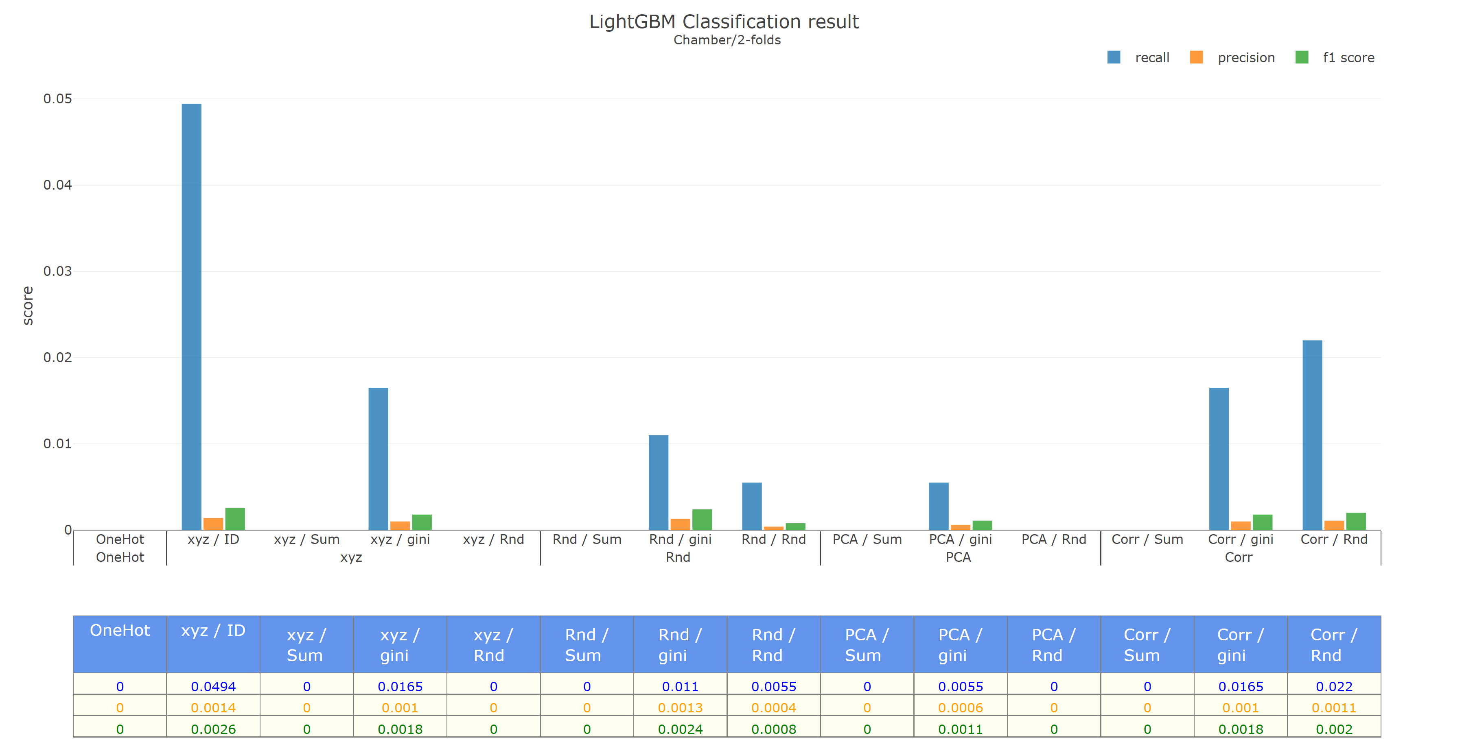
Original | Chamber | 2-folds

Slide 24
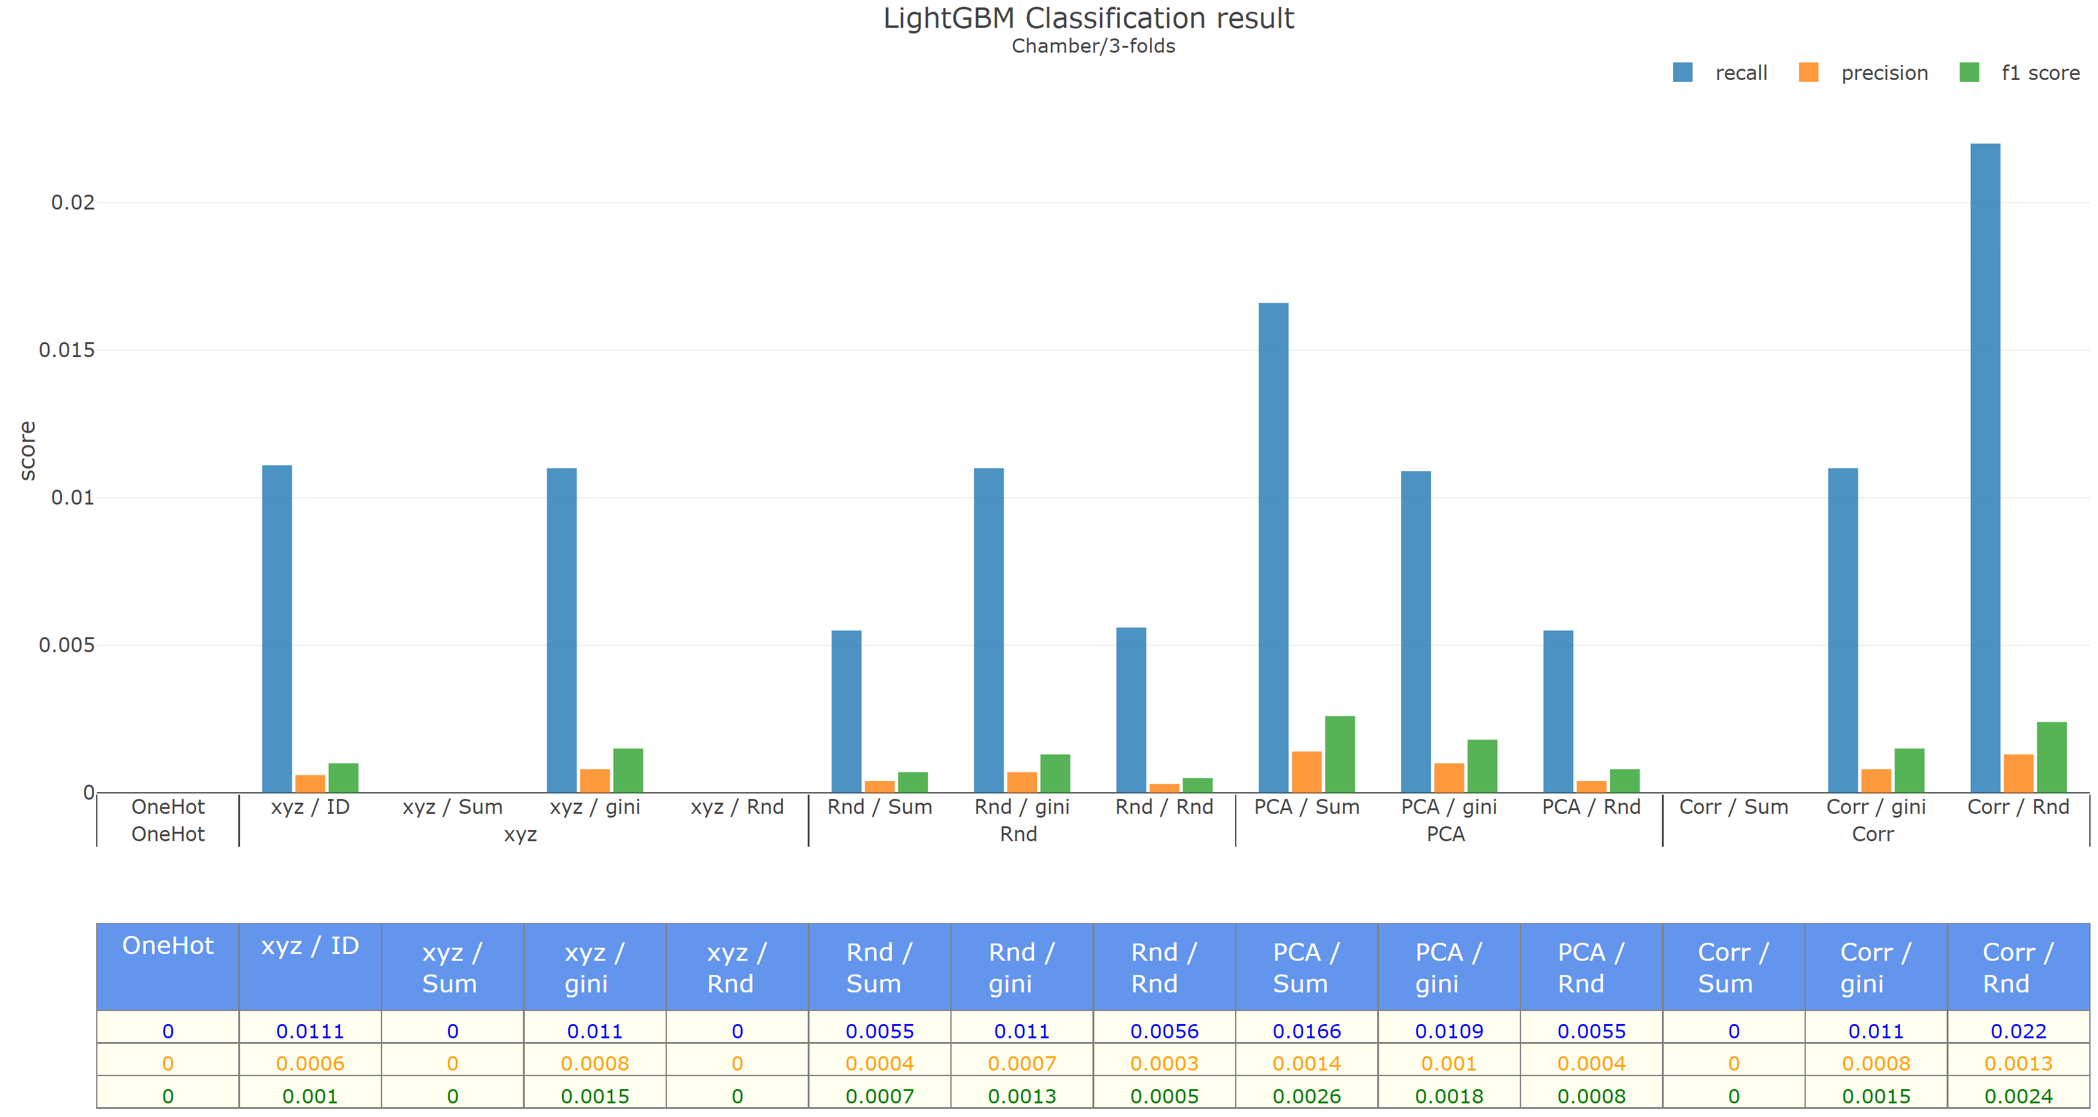
Original | Chamber | 3-folds

Slide 25
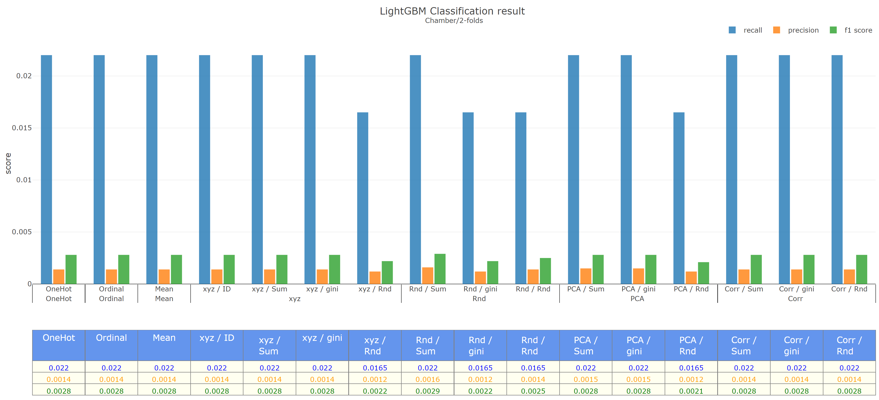
Backward | Machine | 2-folds

Slide 26
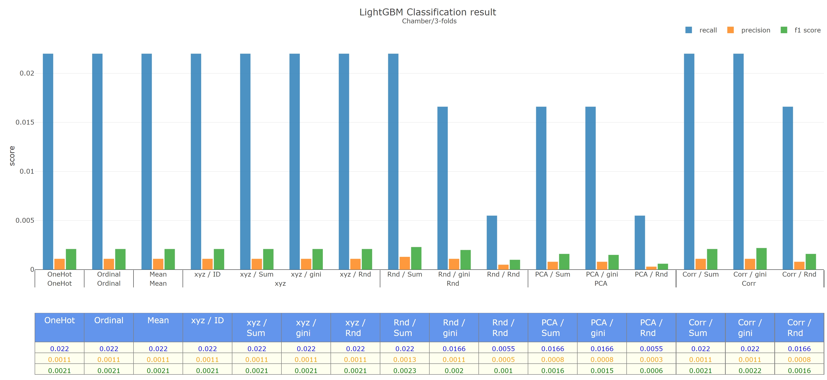
Backward | Machine | 3-folds

Slide 27
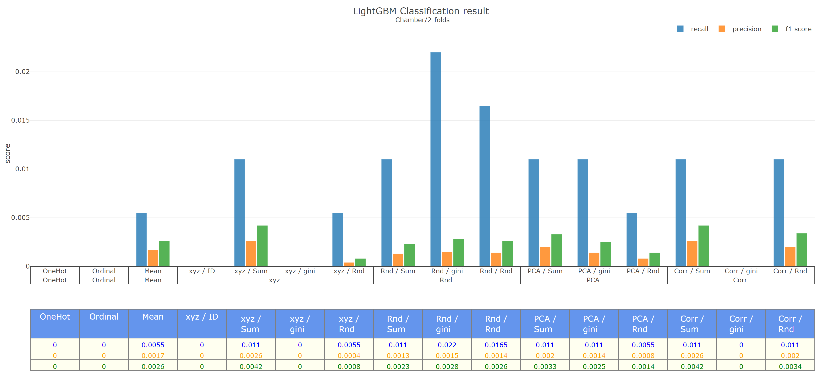
Backward | Chamber | 2-folds

Slide 28
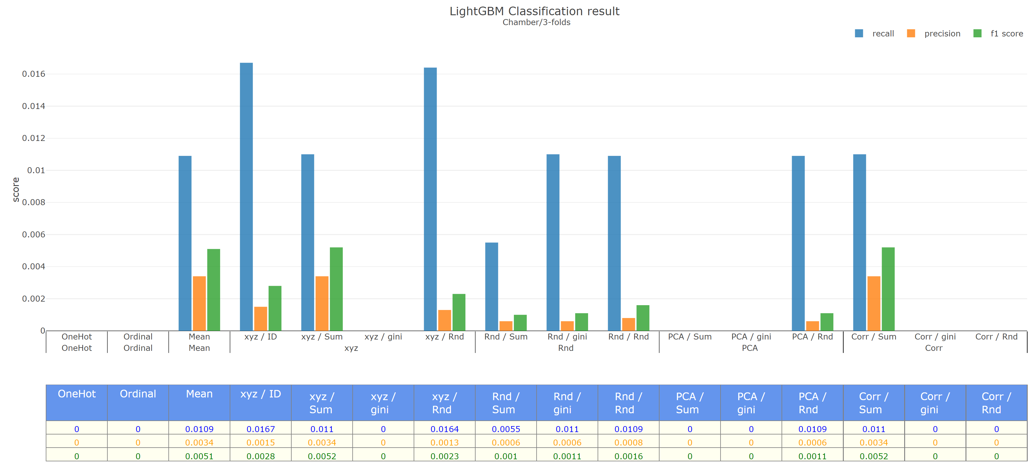
Backward | Chamber | 3-folds

Slide 29
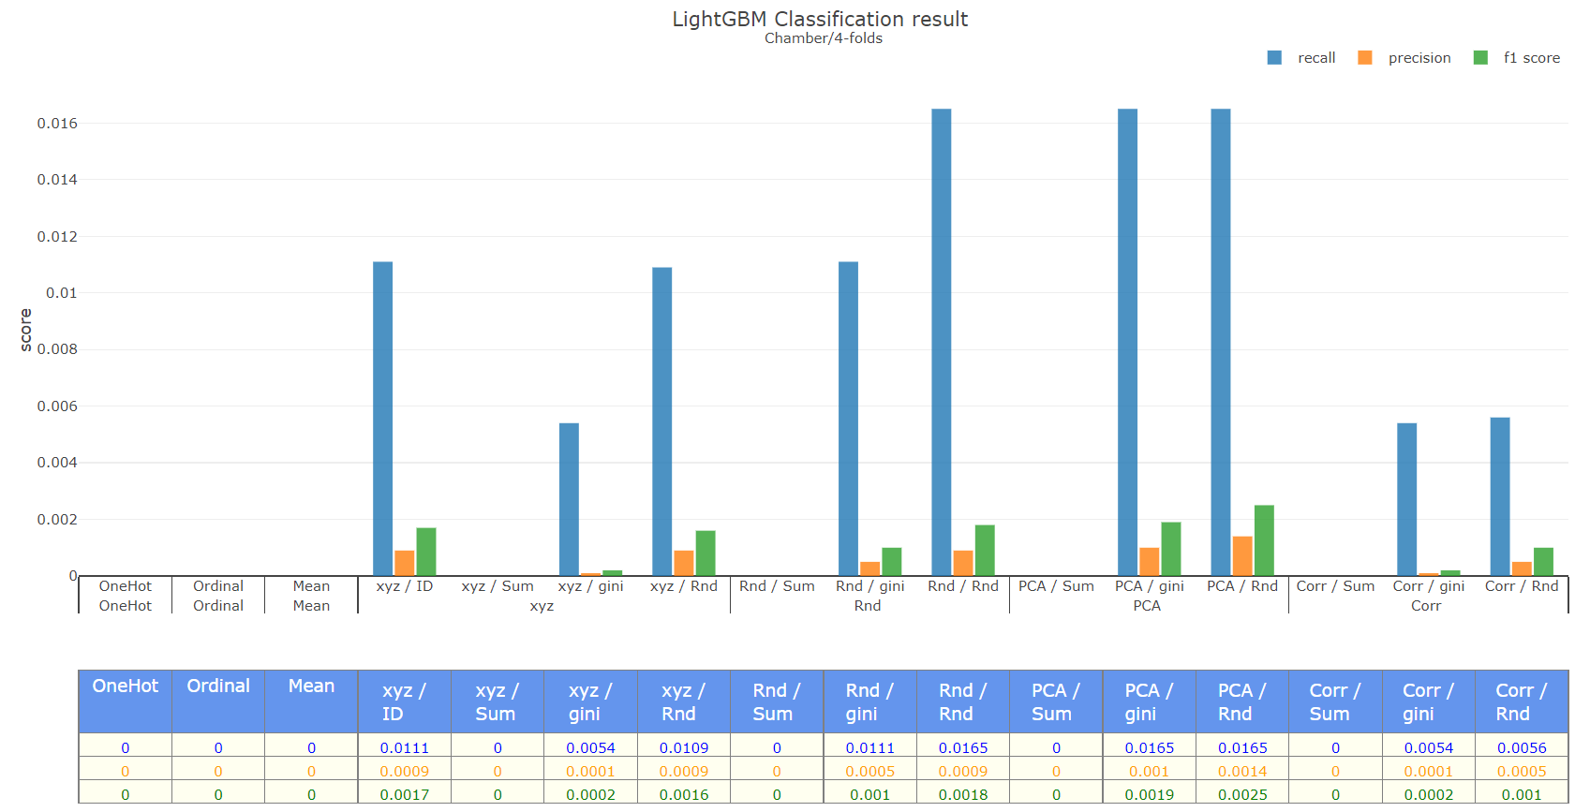
Backward | Chamber | 4-folds
Notes:
個別bad

Slide 30
To do
Conference
PPT
Dataset
AUO
UCI highly imbalance
Code
Clean code
Feature importance
Notes:
個別bad

